Slide 1


Trading Diamonds Safely: Protecting Yourself From Online Scams And Fraud
Notes:
Welcome
My Name is Saville Stern – manage the RapNet division of Rapaport
Today we are going to be talking about “trading diamonds safely and how to protect yourself from scams and frauds”
Reason we are discussing this today is that there are a number of scams happening now, getting worse and we want to highlight the issues and encourage awareness and vigilance.

Slide 2
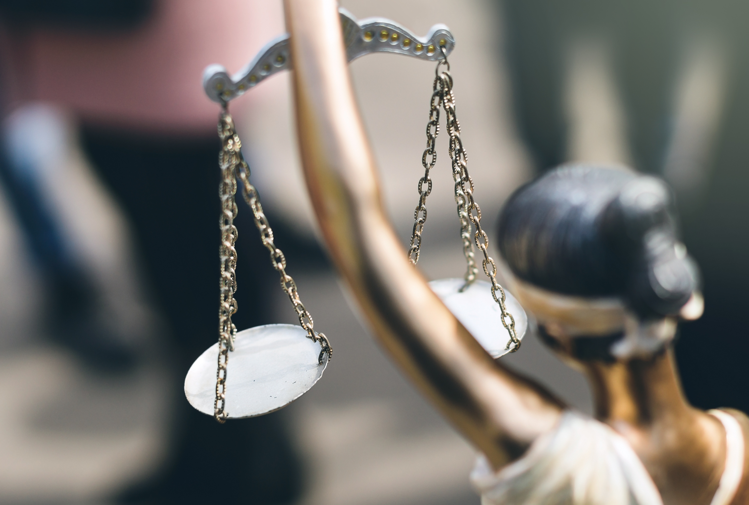
RapNet And The Rapaport Group
Rapaport Values:
Ethical, Transparent, Competitive, Efficient Markets
Background
Established in 1978
Global, 230 Employees, 7 Offices, 5 Countries
Over 20,000 clients in 121 Countries
Added Value Services
Do not trade diamonds on our own account

Slide 3
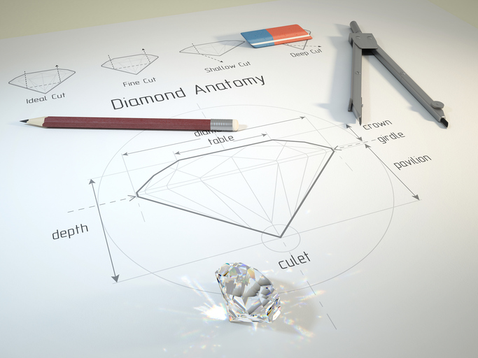
RapNet And The Rapaport Group
Rapaport Price Sheet and Magazine
RapNet – Diamond Trading Network
Diamond Grading and Certification
Rapaport Auctions and Trading Services

Slide 4
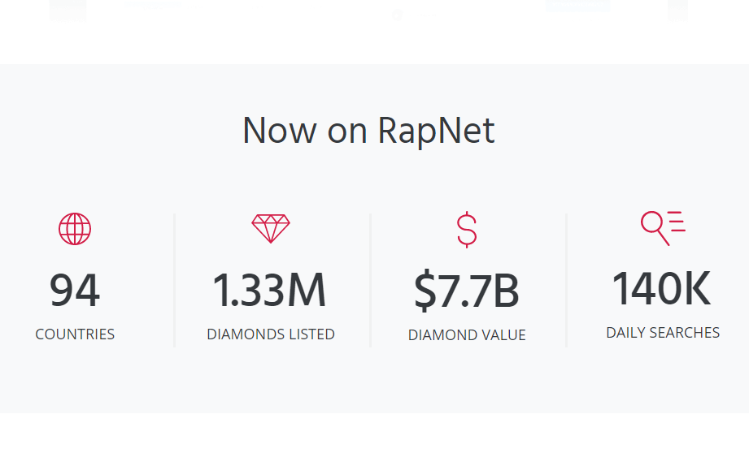
Notes:
Presented by Rapnet, a Rapaport Group Company
RapNet is the largest diamond trading network in the world,
with over 1m diamonds offered for sale daily
with members in 94 countries.
Daily inventory is approximately $7.5B, estimated to be about 70% of the available b2b diamonds for sale.

Slide 5

Thank You
Sherri Hendricks and the entire Las Vegas office
Jonny Katz, Benzi Kluwgant and our Israel team

Slide 6

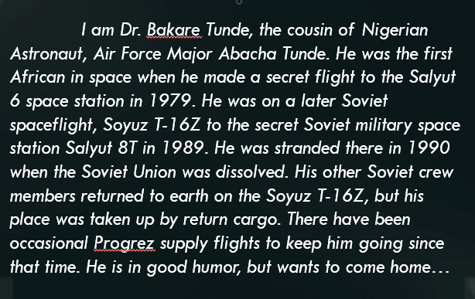
Scams and threats – Nigerian Scams
Notes:
Basic idea of a Niegrian scam is to part money from the gullible. These scams predate the internet – the history of Nigerian scams can be traced back to 1920s when mass mails sent out by a man claiming to have mystical powers and would perform magic for a fee on anyone you chose.
Of course the internet changed everything and allowed for real mass no cost distribution and the Nigerian scheme, in my view, has reached a peak of its art form in this letter (read letter)
So this is an easy to understand scheme.

Slide 7
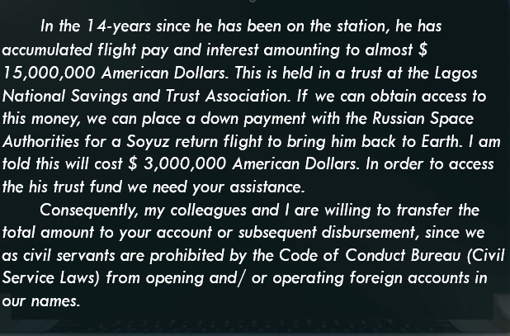

Slide 8

Scans & Scammers
Those scams are made for gullible people
Anyone responding to that is a “qualified lead”
However, scams get more sophisticated
Notes:
Its straight forward. Mass email to random unknown people around the world

Slide 9

Sophisticated Setups
Social engineering
Cyber attacks
hacking
phishing
Notes:
Explain phishing. Phishing – server in dubai that was a furniture manufacturer. Didn’t know they had left their server unsecured. Someone else had put up a page that looked like RapNet and was sending emails telling people to log in or their account would be locked. Stealing RapNet passwords. After login they redirected you to RapNet terms and conditions page. Many members were so fooled by it, even after we told them they didn’t realize they had been victims. The furniture company got their IT to remove the page and I hope fix their server
Social engineering to get passwords. Perhaps they watch you on facebook for a while. Get to know your dogs name, your husbands birthday
Scam on dating sites – string you along for months. Send flowers etc… Then when you arrange to meet, they say they are booking a ticket, but need to go via – you guessed it – Nigeria to help their son settle in at a job/job interview etc… Then the next you hear they have been in an accident. Robbed. Need money urgently for medical care and have no access to their credit card. Would you send them money? I mean they sent you flowers, were flying to meet you…

Slide 10

Scams In Our Industry
We are no strangers to scams in our industry
RapNet traded in 2016:
3.63m diamonds traded
$14.3B total value sold
Our members deal directly with each other, but when there is a problem, we step in to assist.
Notes:
Whether it’s a new diamond treatment that remains undisclosed and undiscovered, or mixing synthetics with natural – or, as was reported by JCK, Ada diamonds that sells only factory produced diamonds found natural mined diamonds in a parcel from one of their suppliers.
We don’t have many reports of the “bait and switch” or “goods not represented properly”
Not one case of synthetic instead of mined
We get a few cases of HPHT diamonds cut to match an original non-treated report. Worst case we have had reported was a type IIa 3 ct D flawless with GIA letter , turned out to be HPHT.

Slide 11

Invoice Modification Scheme first type of fraud
Definition:
“A sophisticated scam targeting businesses working with foreign suppliers and/or businesses that regularly perform wire transfer payments. The scam is carried out by compromising legitimate business e-mail accounts through social engineering or computer intrusion techniques to conduct unauthorized transfers of funds.”
Notes:
Fbi definition

Slide 12
Invoice Modification Scheme
Usually have the following attributes
Businesses using free email accounts are predominately targeted (suppliers as well as buyers)
Spoofed emails that closely mimic a legitimate email
Hacked email accounts – thieves lurk in your email account until they can insert themselves into a transaction
Know the language of the trade
Often use triangular setup – supplier in India (mainly), buyer in another country, bank account in a third country.

Slide 13
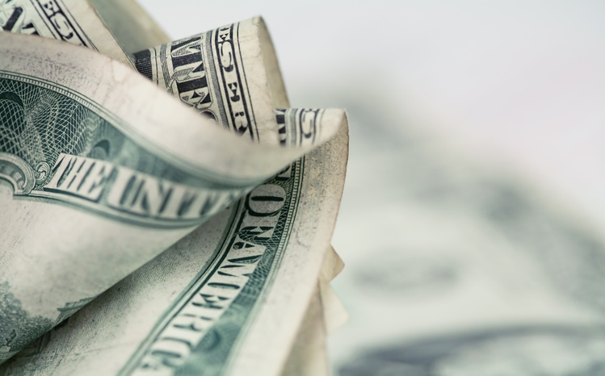
Invoice Modification Scheme
Example email:
“Our bank account in India is undergoing an audit and we cannot access funds. We request you to transfer the payment to our bank in China so as not to hold up shipping.”
Notes:
Find this email in archive

Slide 14
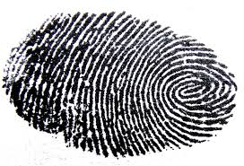
Impersonating A Retailer Second type of fraud
Definition:
“A complicated scam involving impersonating a buyer, altering the usual shipping address and then high value merchandise is shipped by various national and international level parcel providers such as DHL, UPS, FedEx and the USPS. Shipments are either sent to the thieves or redirected by the thieves once in transit”

Slide 15
Impersonation Scheme
Usually have the following attributes:
Very convincing
Speak the language of the diamond trade
Always dangle a bigger deal “Send me the 3ct and we will see about the 4.5 ct later”
Know who they are dealing with – usually call a seller impersonating an existing customer. Likely used social engineering/phishing/hacking
Often coincide with business travel dates

Slide 16

The Extent Of The Problem
We have reported to us over 30 cases since 2015
USD value of stolen money is over $400,000 that we know of
Many cases are not reported to us, especially impersonation schemes
Notes:
Shakes confidence
Makes doing business problematic and inefficinet

Slide 17

So What Can We Do?
There is no magic cure
The scam industry is like any other. It thrives on innovation.
You may not fall for the Nigerian Astronaut scheme, but it is possible you would pay an invoice for goods you ordered without checking the bank details

Slide 18

How Do We Protect Ourselves?
There are three main thrusts to protection
Cyber security
Vigilance and common sense
Safe trading methods

Slide 19

Cyber Security
Connected computers and networks are unsafe.
The question isn’t securing your systems against break in. Its how long before you find out you are hacked and how you react to it.
Notes:
It’s a given you wil be hacked. It’s the extent of the damage the hack causes that’s important.
And the damage gets worse the longer the hack is undetected.
And once detected, must deal with it swiftly and decisively.

Slide 20
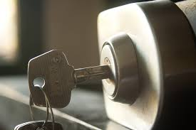
Vigilance & Common Sense
Take extra precaution in the case of a first time customer/supplier OR if the shipping address or bank details of an existing customer changes
Before making a payment, call the seller to confirm and verify their banking details
Make sure account names on the bank wire information match the seller company names.
Only transfer money to a bank located in the same city as the seller. Any other transfer should be confirmed by telephone with the seller.

Slide 21
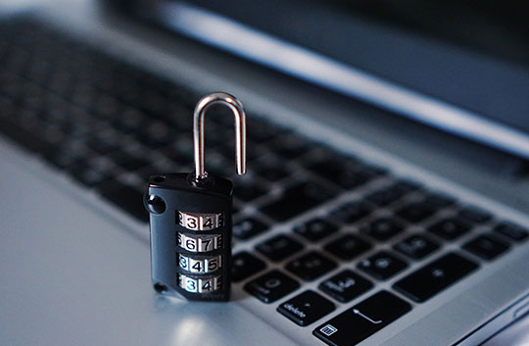
Safe Trading Methods
RapNet educates its members. We post blogs on safe trading, have a safety and security center, announce each time a fraud is reported to us. However, this does not stop the thieves nor does the supply of victims dry up.
RapNet has invested large sums in an upgraded, more secure network that will be rolled out in the coming months.
Notes:
Two of the most obvious security features we will be launching soon are two factor authentication and a reimagined communication center. I want to introduce those to you today.

Slide 22

What Is Two Factor Authentication?
What you know
What you have
What you are
Notes:
RapNet is using the what you know – your password and what you have – your mobile phone as the two factors.

Slide 23
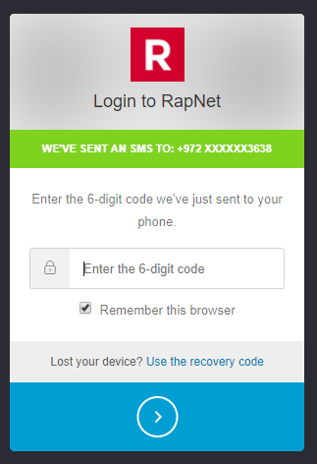
RapNet Safe And Secure Trading, Introducing: Two-factor Authentication

Slide 24

RapNet Safe And Secure Trading Introducing Secure Communications
Communicate only via the RapNet website
No insecure emails
Record of all negotiations between the parties

Slide 25
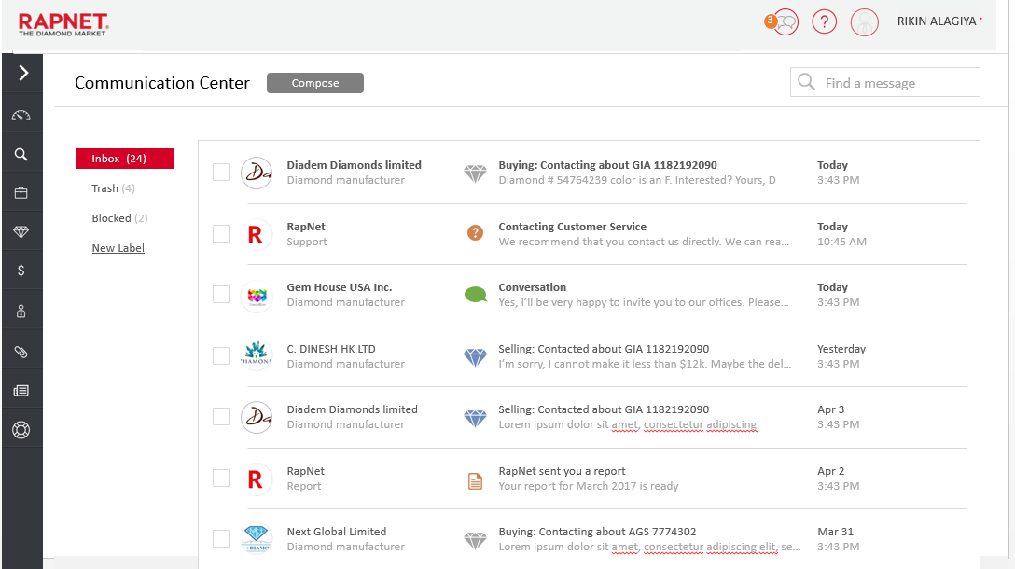

Slide 26
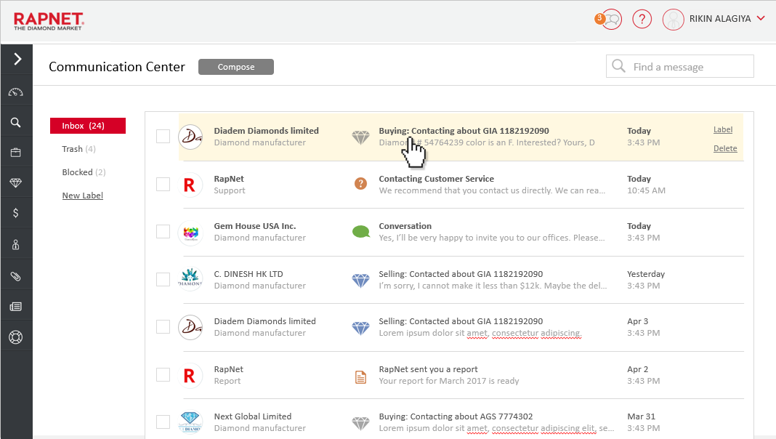

Slide 27
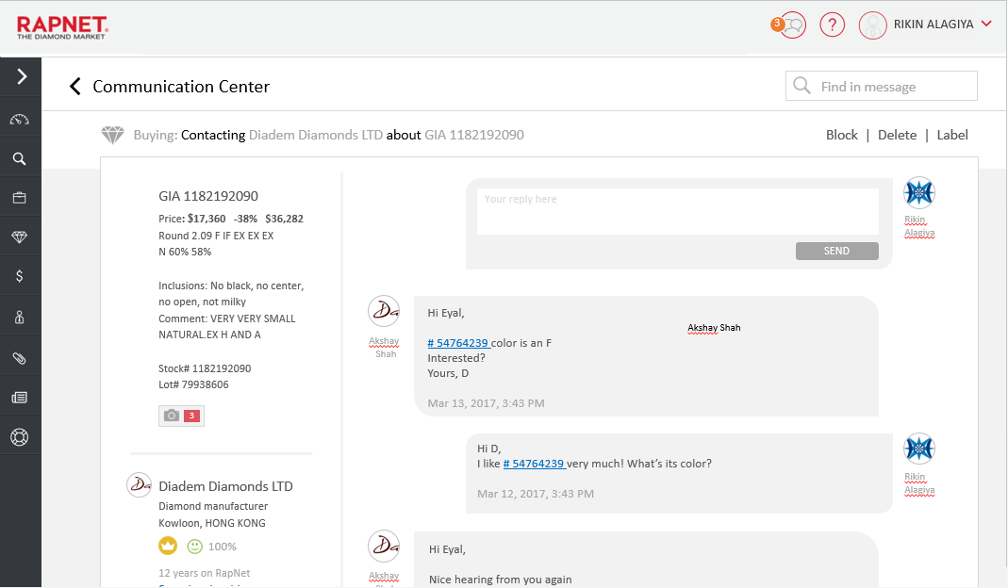

Slide 28
RapNet – the safest way to trade is getting safer
Securing identity of the party logging in with 2FA
All communication only on the secure site and not via insecure emails.
Notes:
Thank you – Questions can be asked during the panel discussion. Would now like to introduce you to our special guest speaker [next slide]

Slide 29

Troy Wilkinson Axiom Cyber Solutions
Notes:
Troy Wilkinson began his career serving others as a Law Enforcement officer. He commanded a Joint Terrorism Task Force, was a lead bomb investigator, and violent crime and homicide detective however his greatest achievement in the field of law enforcement came from his ability and skill investigating and prosecuting child pornography and other electronic crimes.
Wilkinson was recruited by the U.S. State Department and he was a top U.S. cyber investigator seconded to the United Nations and European Union to lead investigations into political corruption, organized crime, war crimes, financial crimes and terrorism.
Troy co-founded Axiom Cyber Solutions, with a mission to develop intelligent, automated, and self-healing cyber security platforms to help secure America’s businesses against cybercriminals.

Slide 30
Panel Discussion
Tiffany Stevens
President & CEO of Jewelers Vigilance Committee
Anthony J. Capuano
President of The Jeweler’s Board of Trade
Ronnie Vanderlinden
President of International Diamond Manufacturers Association
Troy Wilkinson
CEO of Axiom Cyber Solutions

Slide 31
Trading Diamonds Safely: Protecting Yourself From Online Scams And Fraud
Notes:
Thank you

Slide 32
Q&A
What checks should I make when opening up an online account?
How do I guard my personal information online?
How often should I change my password
How are hackers gaining access to my personal email account?
How do I spot a hacker?
If I am doing business internationally what are the best tips for practicing safe business?
How do I know as a jewelry retailer that RapNet is a safe trading platform?

